Slide 1
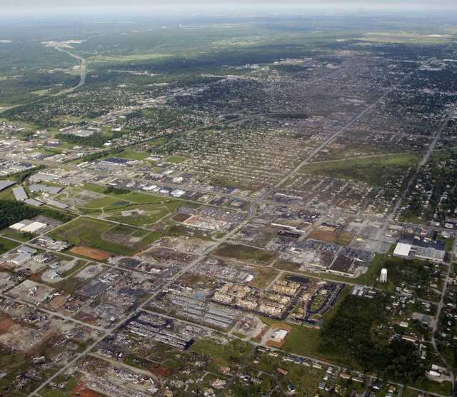
Response Industrial Hygiene and Safety Professionals:
Are You Prepared to Respond to a Disaster or Incident?
M. Bernard,
FEMA Region X
Bothell, WA;
05/07/2013
Notes:
How many of you have taken Incident Command System, ICS courses? ICS 100-200? 300-400? All Hazards Position Specific Courses?
How many of you have been involved in an incident exercise using the National Incident Management System, NIMS processes like ICS?
How many of you have responded to a small, medium to large incident ?
How many of you have actually responded to a medium or a large incident as an industrial hygienist?
How many of you have actually responded to a medium or a large incident as the Safety Officer for the incident?
Safety will include environmental health of the responders.
Public health will be an issue in most any response.

Slide 2
NIMS and the Incident Safety Officer

Slide 3
NRF/NIMS Coordination Structures
Field Level
Regional Level
NationalLevel
NIMS Role
Multiagency Coordination System
National Incident Coordinator
Multiagency Coordination Entity
Strategic coordination
Multiagency Coordination Centers/EOCs
Support and coordination
Joint Field Office
Regional Response Coordination Center
National
Response
Coordination
Center
Local Emergency Operations Center
State Emergency Operations Center
Incident Command
Directing on-scene emergency
management
A Local Area Command is established when needed due to the complexity or number of incidents.
Local
Area
Command
Role of regional components varies depending on scope and magnitude of the incident.
Incident Command Post
Incident Command Post
Incident Command Post
Notes:
The structure for NRP coordination is based on the NIMS that utilizes Incident Command structures on-scene supported by a Multiagency Coordination System, which consists of:
Multiagency Coordination Entities; and
Multiagency Coordination Centers/Emergency Operations Centers.
Reflecting the NIMS construct, the NRP includes the following command and coordination structures:
- ICPs on-scene using the Incident Command System (ICS)/Unified Command;
- Area Command (if needed);
- State, local, tribal, and private sector EOCs;
- JFO, which is responsible for coordinating Federal assistance and supporting incident management activities locally;
- RRCC and HSOC, which serve as regional and national-level multiagency situational awareness and operational coordination centers; and
- IIMG, which serves as the national headquarters-level multiagency strategic coordination entity for domestic incident management.
This structure addresses both site-specific incident management activities and the broader regional or national issues related to the incident.

Slide 4
Unified Command
Co-management of incident
Overlapping jurisdictional / agency responsibilities
Coordination of efforts
Responsive to community based response organization
Can be used for single and area commands

Slide 5
Organization
Unified Command
Or
Command Staff
General
Staff

Slide 6
NIMS Incident Complexity Types
Type 1 - Most complex, requiring national resources for safe and effective management and operation
Type 2 - Incident extends beyond the capabilities for local control and is expected to go into multiple operational periods
Type 3 - Incident needs exceed capabilities, the appropriate ICS positions should be added to match the complexity of the incident
Type 4 - Command staff and general staff functions are activated only if needed
Type 5 - The incident can be handled with one or two single resources with up to six personnel

Slide 7
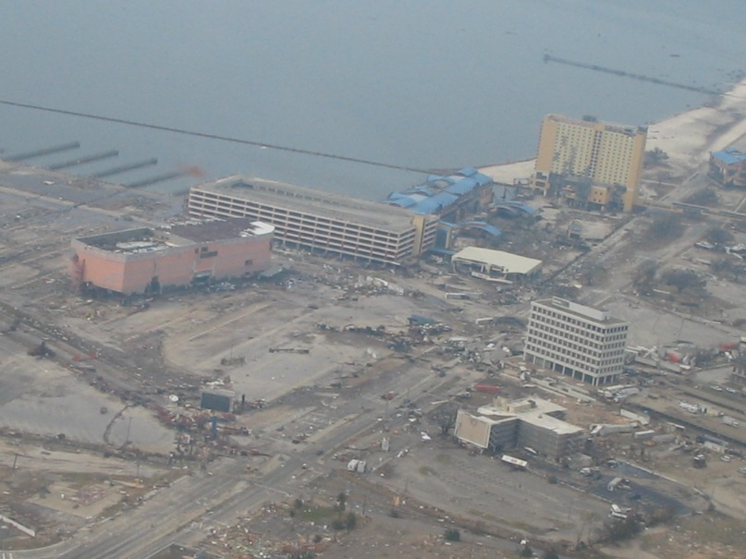
ICS Safety In the Field
An Incident Command System (ICS) Safety Officer (SOFR) at a type three incident or higher must have the experience and meet the qualifications to attend one of the Emergency Management Institute (EMI) or similar other agency based curricula all hazards incident specific type three or higher safety officer courses.
Notes:
To be a Safety Officer in an incident (Type three or higher) using ICS there are a number of training and experiential qualification

Slide 8
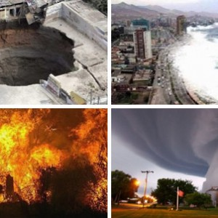
ICS Safety In the Field cont.
For type 2 or type 1 incidents the Wildfire and other federal agencies have developed specific training and qualifications to be a safety officer at those levels. There is no Federal Emergency Management Agency FEMA All Hazards qualification yet at the type 2 or 1 level.

Slide 9

ICS Safety In the Field cont.
Generally the SOFR needs to have experience/background in the type of incident that the person is going to be working in (industrial hygiene, hazardous materials, fire, flooding, biohazard, health, radioactive etc.). The SOFR will also have to have a general safety background to be aware of and able to effectively protect response personnel from these types of hazards.

Slide 10
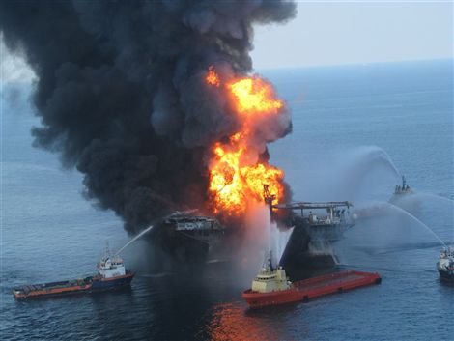
ICS Safety In the Field cont.
The SOFR also needs to be able to develop an incident or site safety plan for all command post and field operations to reduce and mitigate risks.

Slide 11
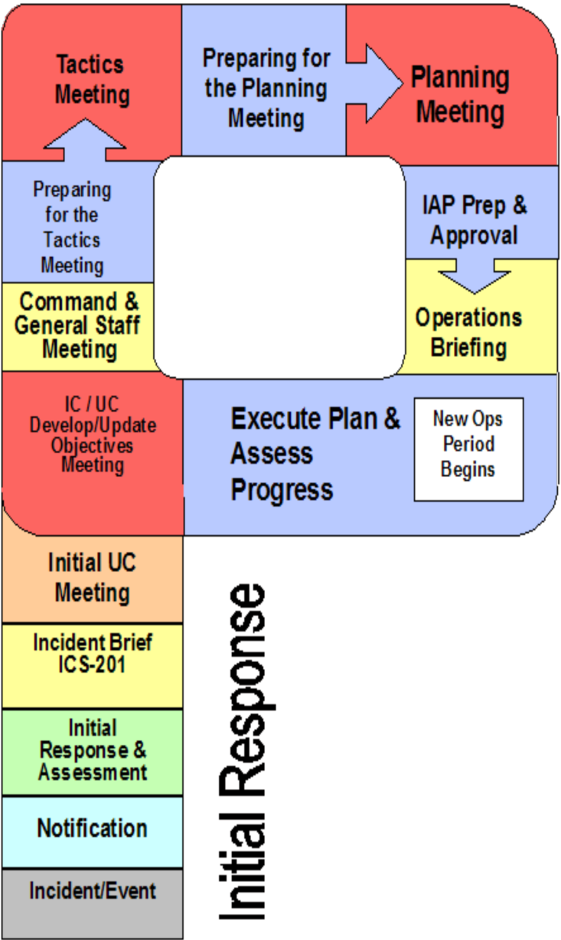
OPS Section Chief develop strategy & tactics (plan of action for next OPS period to meet IC/UC direction, priorities, & objectives
Block of time set aside for the Command & General Staff to prepare for the Planning meeting, updating charts, maps, & OPS Section Chief’s plan of action, i.e., Safety Plan, etc.
Meeting for the IC/UC, Command & General Staff, to review planned actions and finalize information that will be incorporated into the Incident Action Plan (IAP)
Get tacit approval from IC/UC on planned actions
Meet and brief Command & General Staff on IC/UC direction, objectives & priorities
Assign work tasks
Resolve problems & clarify staff roles and responsibilities
Time block set aside for completing all documentation associated with the IAP
IC/UC approves IAP
Duplicate plan for distribution
Establish priorities
Develop response objectives
Identify response emphasis
Agree on operating policy, procedures and guidelines
Planning
P
Provide operations briefing to Ops Sec Personnel
Ensure support to operations in place
Deploy next operating period resources
Determine UC representatives
Agree on organization structure
Identify command post & support facilities
Order appropriate staffing
Brief command on initial response activities
Clarify issues & concerns
Discuss planned operations & direction
Identify incident escalation potential
Monitor on-going operations & make tactical adjustments
Measure/ensure progress against stated objectives
Debrief resources coming off shift
Prepare to brief UC/Planning on accomplishments
Management initial response activities
Conduct Initial Assessment
Develop plan of action
Complete ICS-201
Prepare for command briefing

Slide 12
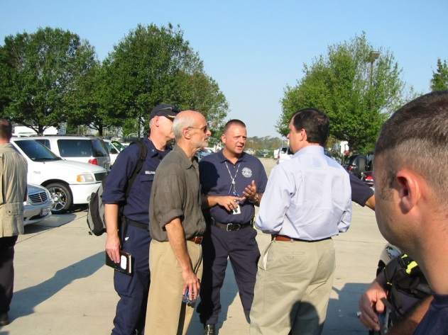
Unified Command Safety
Unified Command
Safety Officer
ASOFR
Air Monitoring
ASOFR
OIL Recovery
ASOFR
Rescue Operations
ASOFR
Marathon
ASOFR
BP
ASOFR
Air Operations
ASOFR
Boat Operations

Slide 13
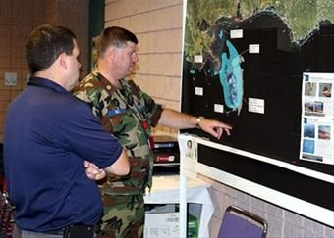
Area Command Definition
A response organization activated to ensure that issues involving Command, Planning, Logistics, and Admin/Finance coordination occurs in support of multiple on-scene Incident Commanders

Slide 14
Area Command Organization
Area Commander/
Unified Area Command
Area Command
Safety Officer
IC/UC 1
Area Command
Public Information Officer
Area Command
Liaison Officer
IC/UC 2
Assistant
Area Commander
Planning
Assistant
Area Commander
Logistics
IC/UC 3
Area Command
Situation
Unit Leader
Area Command
Critical Resources
Unit Leader

Slide 15
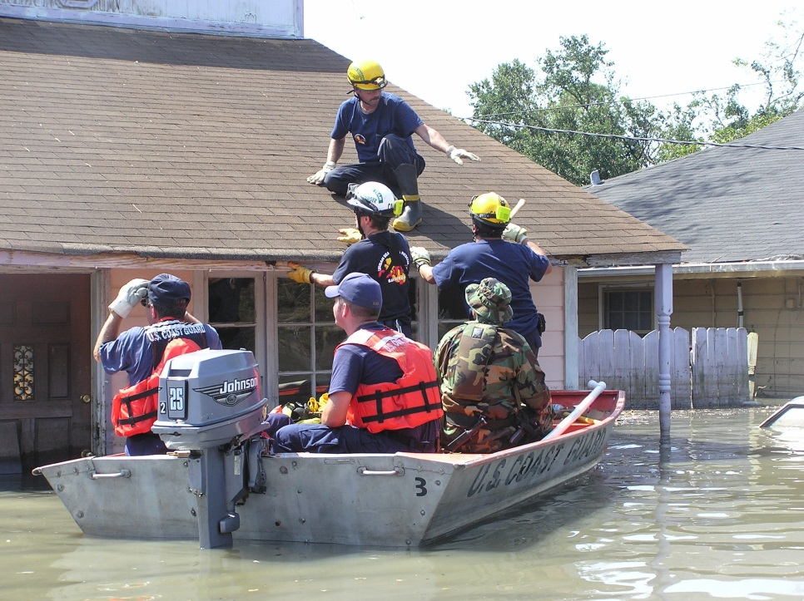
Multiple Incident Safety Chain
Area Command
Safety Officer
IC/UC 1
SOFR
IC/UC 2
SOFR
IC/UC 3
SOFR

Slide 16
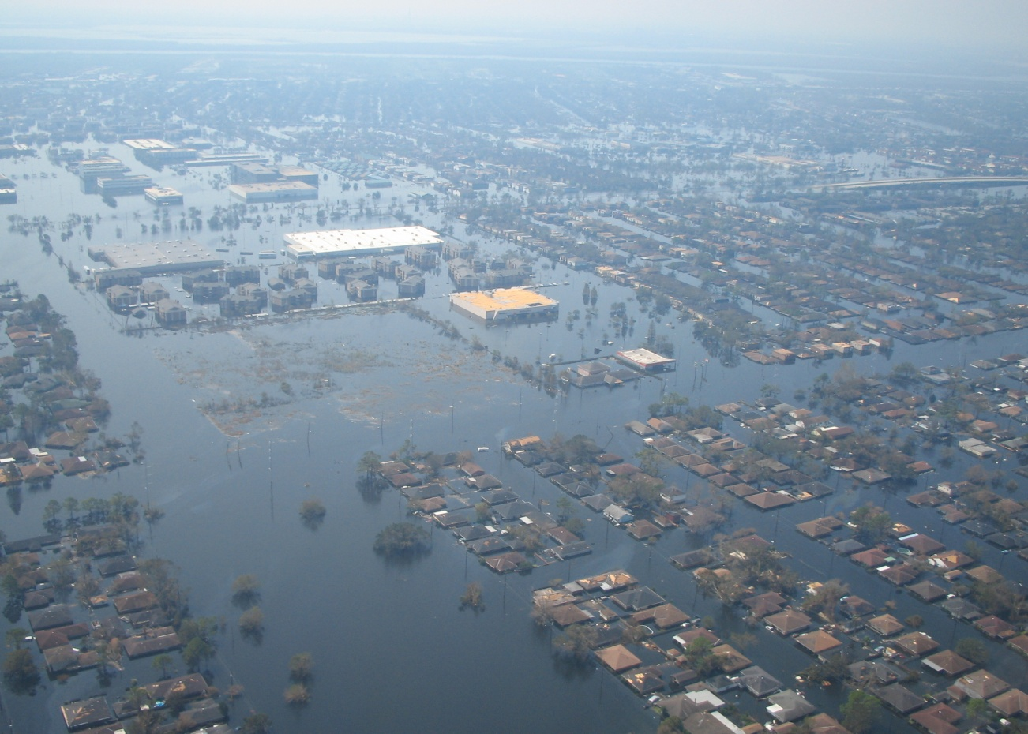
PREPARING FOR AND RESPONDING
TO THE INCIDENT
Notes:
During Hurricane Katrina and Sandy, a large percentage of the Safety and Assistant Safety officers were industrial hygienists from US Public health, EPA and OSHA.

Slide 17
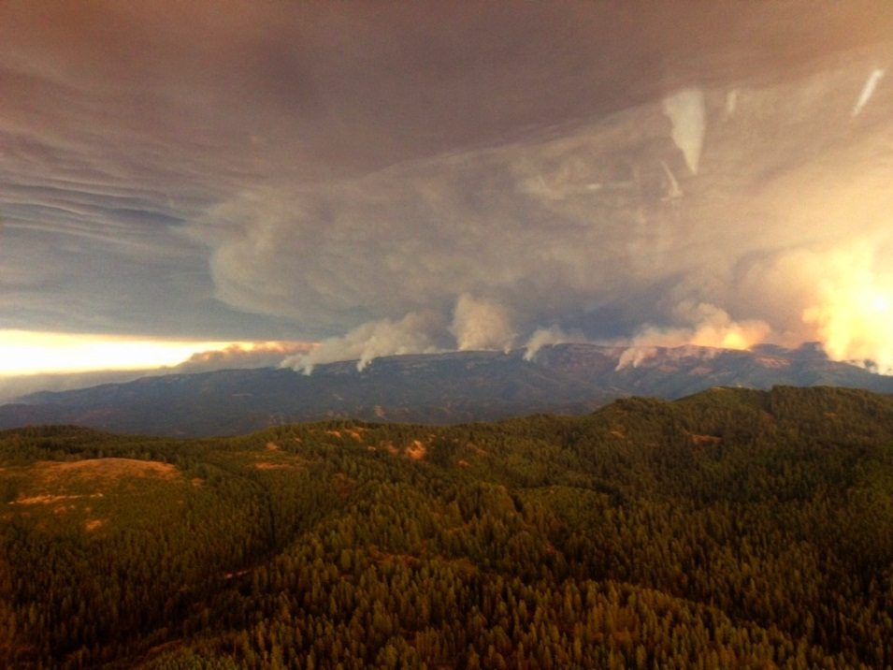
PREPARE TO PREVENT SAFETY INCIDENTS IN A LARGE DISASTER
Safety Response is a function of:
Planning, Training and Preparation.
Identifying enough qualified personnel with the right credentials.
Personnel that can deploy in a large event.
      These personnel do not necessarily
      need to be from your agency
      but can be from any of the
      federal state and local agencies
      that are connected with your
      area plan.
Table Mountain Fire 2012
Notes:
Mention Threat Hazard Identification Risk Analysis how it applies to planning and resources

Slide 18
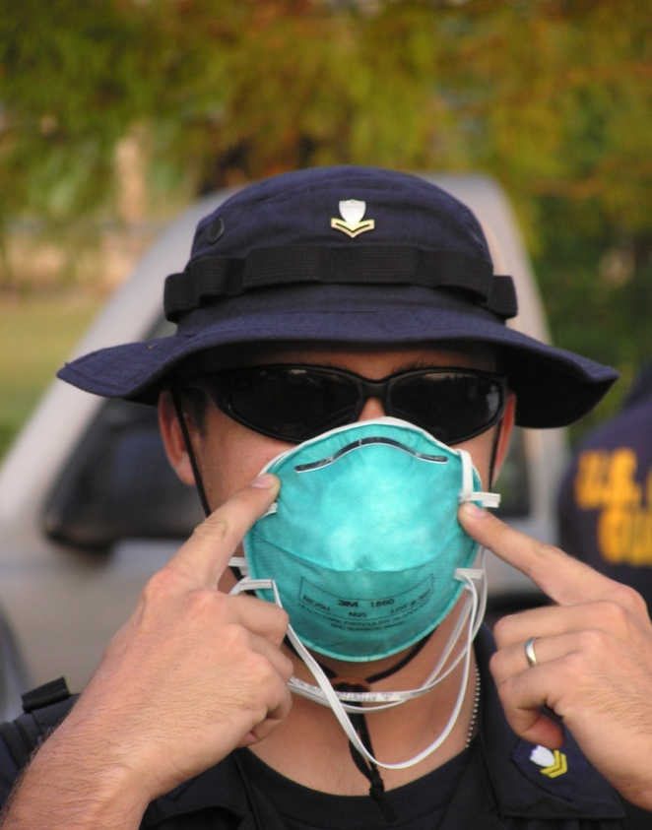
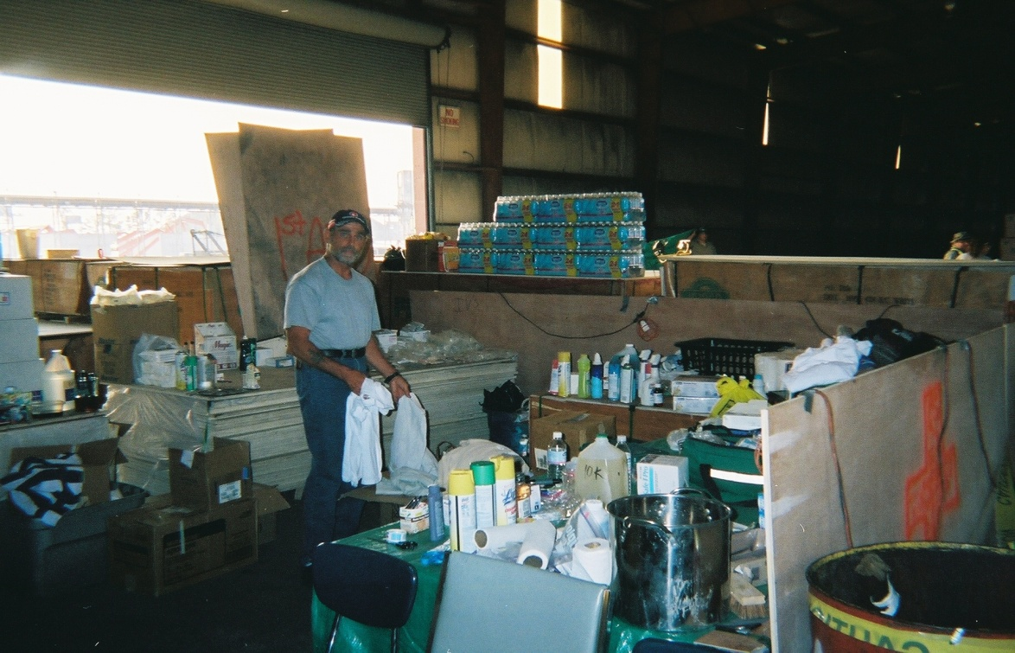
PREPARE TO PREVENT SAFETY INCIDENTS IN A LARGE DISASTER
Agreements with other agencies worked out in advance can allow for quick response of their personnel.
Inventories of equipment that the agencies have;
lists of equipment you will need with sources can quickly put what you need for the incident in your hands for the response
Notes:
Memorandums of Understanding, Memorandum of Agreements, Joint planning, Equipment typing, Resource Typing library Tool

Slide 19
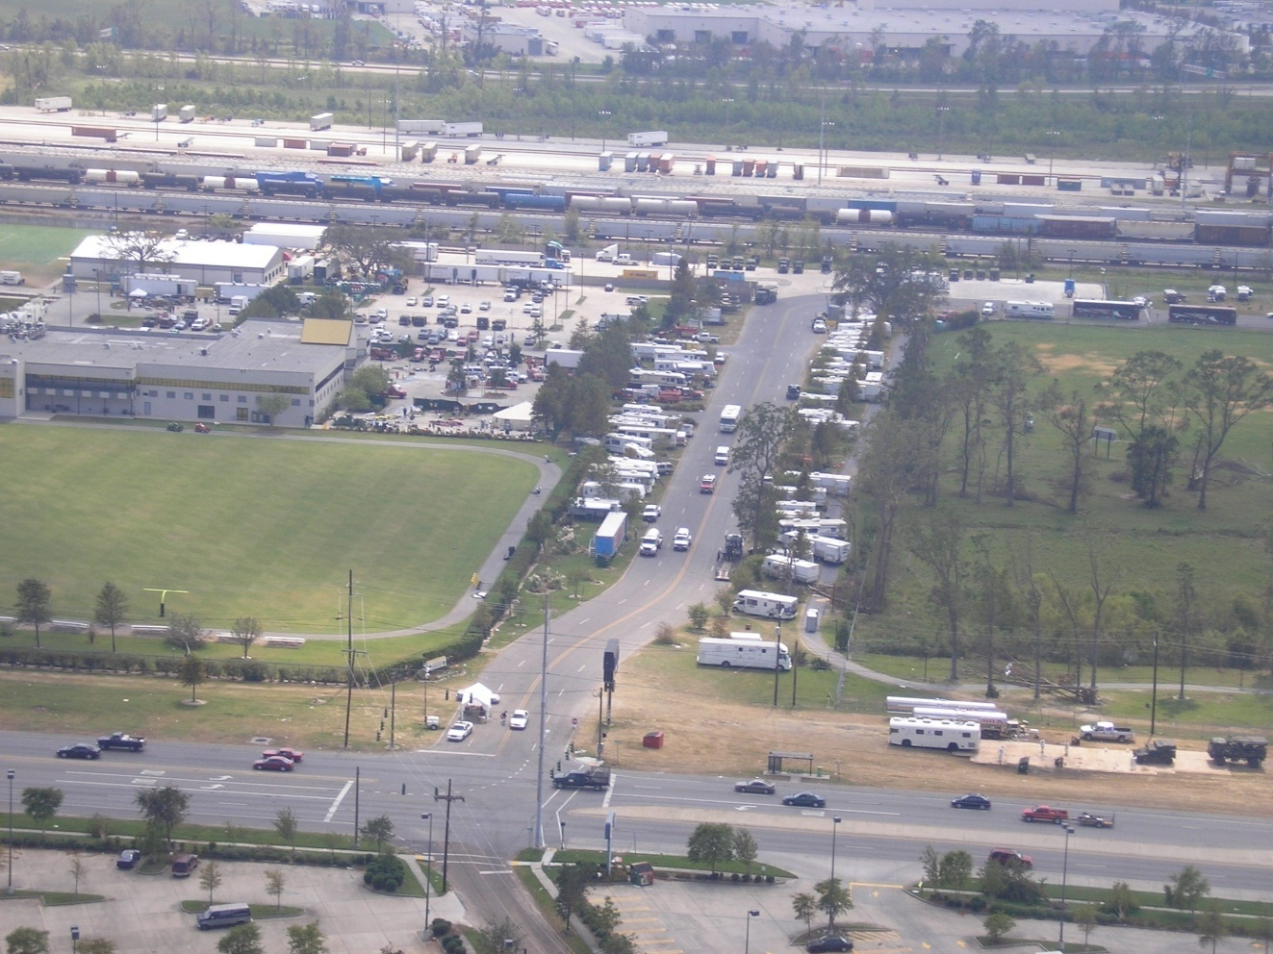
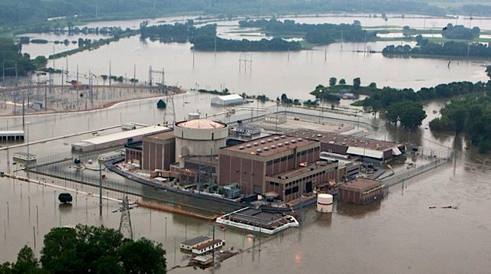
PREPARE TO PREVENT SAFETY INCIDENTS IN A LARGE DISASTER
Site Safety Plans (ICS 208 Forms) should be developed as soon as possible
    Having several types of other generic Site safety Plans from
    other response incidents can cut down development time.
Notes:
Mention sources

Slide 20
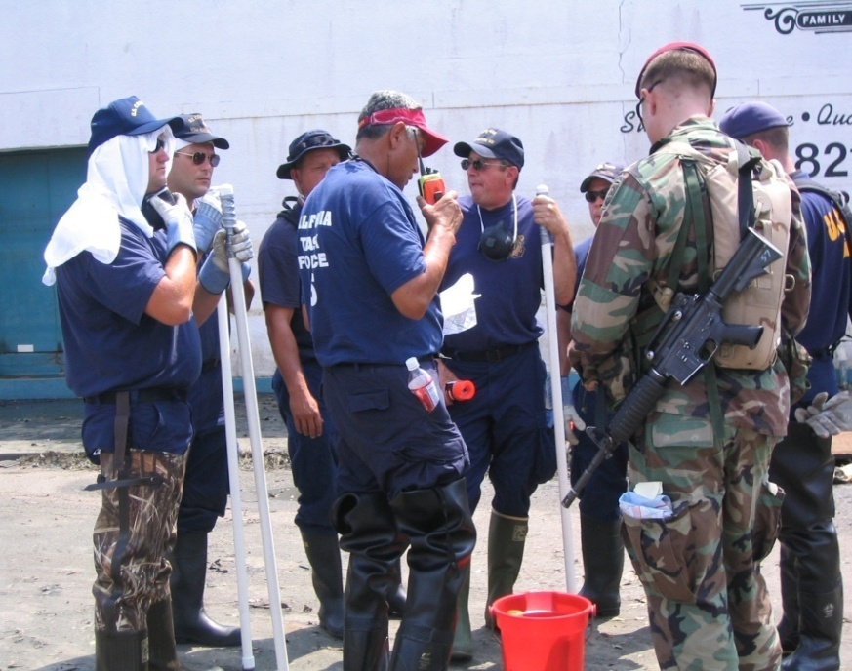
PREPARE TO PREVENT SAFETY INCIDENTS IN A LARGE DISASTER
Get qualified Safety Assistants(SA) in the field as soon as possible
    Must be properly equipped for the conditions
    Must have reasonable shelter and facilities
    Need to have working communications
    Need to be located initially at key staging areas
    Should initially go out with teams to see how they are
    dealing with the incident response
    hazards
    Set up regular information
    downloads from SA’s on a
    time staggered basis
Notes:
Talk about qualifications

Slide 21
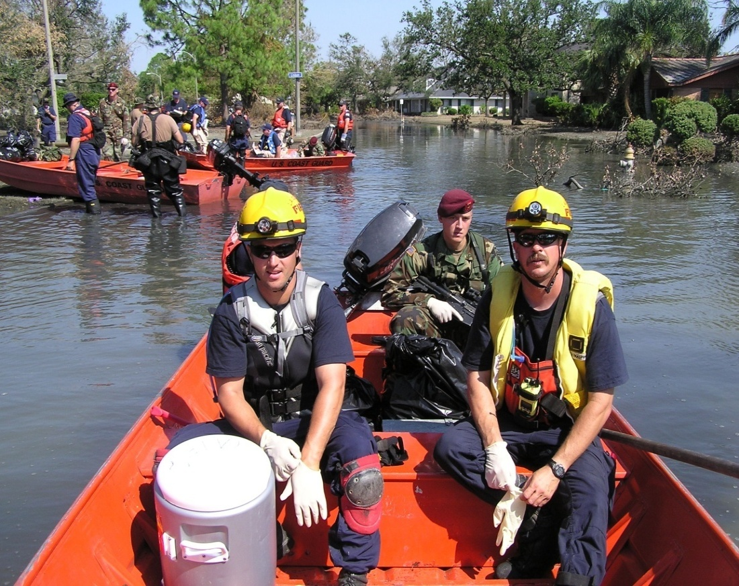
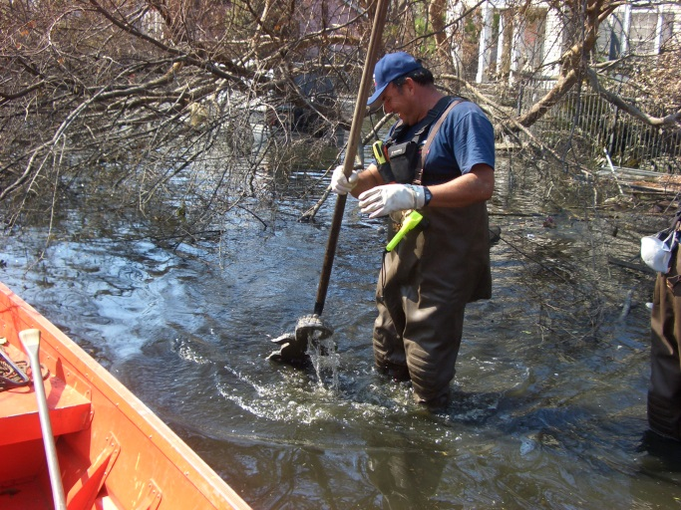
PREPARE TO PREVENT SAFETY INCIDENTS IN A LARGE DISASTER
Most incidents of this type will have evolved into an ICS Unified Command type of response.
A pre-filled out ICS 213 Message form with initial equipment an personnel resource needs can save time as it can be delivered to the logistics section by fax or upon your
arrival to the Incident Command
Post.

Slide 22
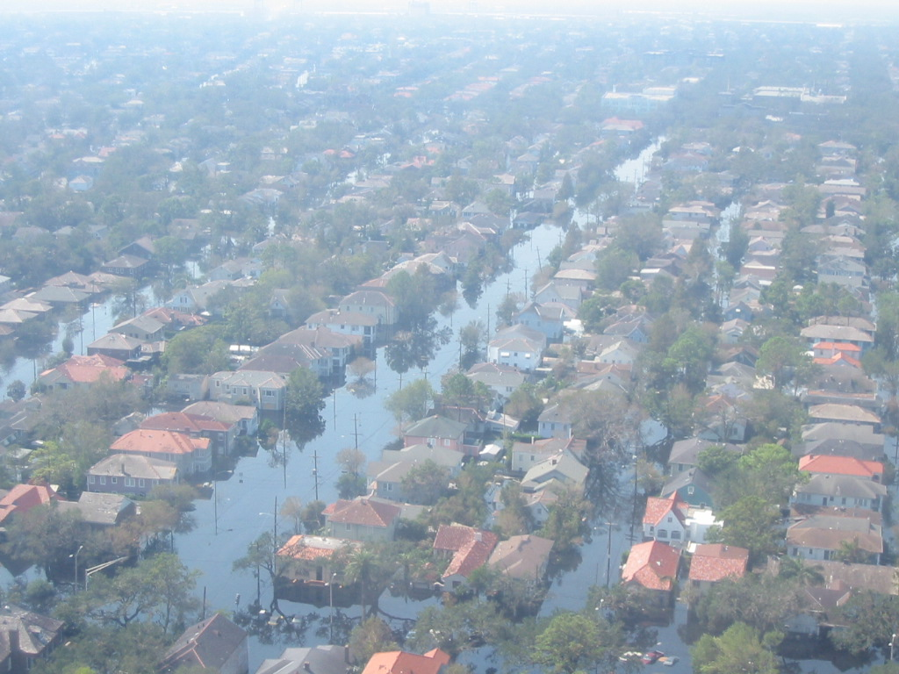
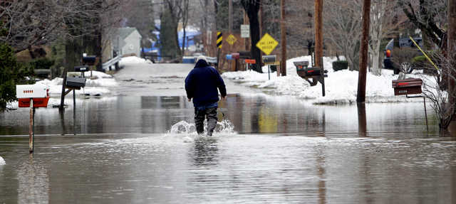
PREPARE TO PREVENT SAFETY INCIDENTS IN A LARGE DISASTER
Qualified safety personnel from your preplanned resource lists can be contacted and issued travel orders.
The message to the Safety Assistants in route should include information on weather and incident conditions, reporting information, length of deployment and equipment to bring.

Slide 23
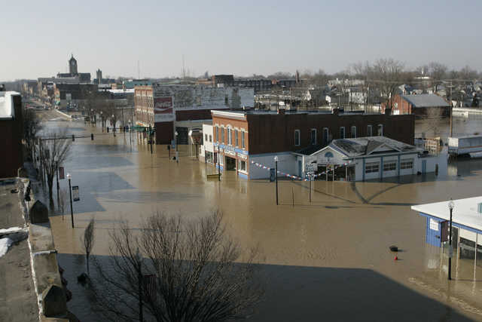
PREPARE TO PREVENT SAFETY INCIDENTS IN A LARGE DISASTER
After the initial site safety plan has been put together assessing the risks and hazard mitigations, a list of personnel protective equipment for the responders, detection and measurement equipment, and equipment and resources for your Safety Assistants needs to be generated.
This can be expedited by using preplanned listing of equipment and resources with
suggested sources that you
had generated for use in
disasters.

Slide 24
PREPARE TO PREVENT SAFETY INCIDENTS IN A LARGE DISASTER
Low Volume Garden Sprayers (4-gal) | None $78.93 | Home Depot 1-800-430-3376
Clorox (1 Gal) | 35417 $9.29 | Home Depot 1-800-430-3376
Mosquito Traps (Mosquito magnet) | None $199.00 | Home Depot 1-800-430-3376
Sampling Devices Nalgene Storm water Sampler, 36” Safety Soil Sampler, 36” | Sampling Devices 11379 $35.20 25406 $141.00 | Lab Safety 1-800-356-0783
The equipment should be ordered next day delivery or as soon as possible. Other sources could include other federal and
DOD agencies that may stockpile specific items.

Slide 25
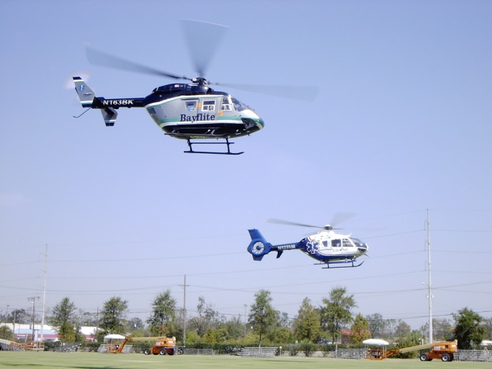
RESOURCE INFORMATION WEBSITES
Haz-Map: Occupational Exposure to Hazardous Agents
http://hazmap.nlm.nih.gov/
OSHA eTools and Electronic Products for Compliance Assistance http://www.osha.gov/dts/osta/oshasoft/index.html
Permissible Exposure Limits (PELs)
http://www.osha.gov/SLTC/pel/index.html
NIOSH Emergency Preparedness and Response
http://www.cdc.gov/niosh/programs/epr/
NIOSH Pocket Guide to Chemical Hazards
http://www.cdc.gov/niosh/npg/default.html
Operational Risk Management Process (ORM)
matthew.bernard2@fema.dhs.gov
ICS Manual Detailed Information
http://www.ecy.wa.gov/programs/spills/preparedness/Drills/drilltrac.html
USCG National Strike Force (NSF) Site
http://www.uscg.mil/hq/nsfweb/default.asp

Slide 26
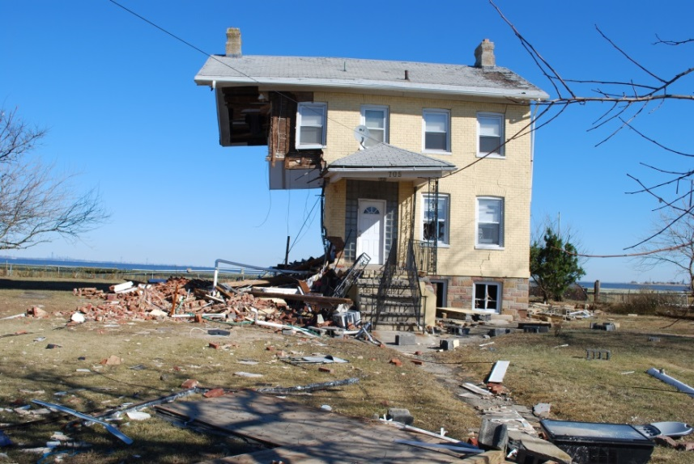
RESOURCE INFORMATION WEBSITES
Weather Information Resources
http://www.weather.com/
NOAA’s Office of Response and Restoration (OR&R) Scientific Support
http://response.restoration.noaa.gov/
USCG Chemical Hazards Response Information System (CHRIS)
http://www.uscg.mil/directives/cim/16000-16999/CIM_16616_6A.pdf
http://wiser.nlm.nih.gov/about.html
Toxic Substances Directory Michigan
http://www.michigan.gov/documents/Draft-InfoDirectory_79334_7.pdf
US Department of Transportation Office of Hazardous Materials Safety Information
http://hazmat.dot.gov/
MSDS Online Link Site
http://www.ilpi.com/msds/index.html#What
American Industrial Hygiene Association Website
http://www.aiha.org/Content
American National Standards Institute
http://webstore.ansi.org/
OSHA Resources on Disaster Recovery Hazards
http://www.osha.gov/OshDoc/hurricaneRecovery.html#fact

Slide 27
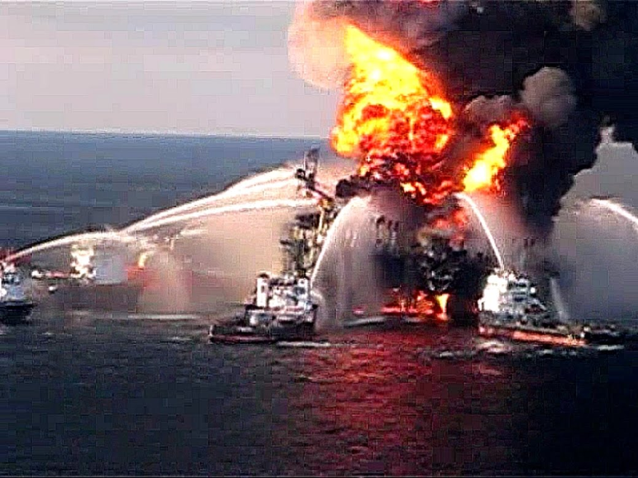
RESOURCE INFORMATION WEBSITES
Occupational Safety & Health Administration Index
http://www.osha.gov/html/a-z-index.html#D
National Institute of Safety & Health Index
http://www.cdc.gov/niosh/npptl/default.html
NIOSH Emergency Response Resources
http://www.cdc.gov/niosh/topics/emres/sitemgt.html
FEMA NIMS Resources
http://www.fema.gov/emergency/nims/index.shtm
National Special Teams Handbook
http://www.uscg.mil/hq/nsfweb/foscr/ASTFOSCRSeminar/References/hazmatteamsguide.pdf
Environmental Protection Agency Emergency Response Team Information
http://www.ert.org/
USCG Homeport ICS Forms and Job Aids
https://homeport.uscg.mil/mycg/portal/ep/home.do
National Response Team Site
http://nrt.org/
Western Response Resource List (WRRL) Oil Spill Resources for West Coast USA
http://www.wrrl.us/index.html

Slide 28

Contact:
Matthew.Bernard2@fema.dhs.gov
FEMA Region 10
425-487-4634

